Slide 1
Approval Testing
Exercise:
- Retrospective

Slide 2
Exercise 1
1. Wrote test for functional code
2. Go to 1
Notes:
Before, we did new stuff, new stuff… we are now doing the same thing many different ways

Slide 3
Exercise 2
1. Capture things with Approvals
2. Capture everything
3. Capture informative output
4. Call a list of inputs
5. Call a combination from 2 inputs
Homework: Method pointers as input

Slide 4
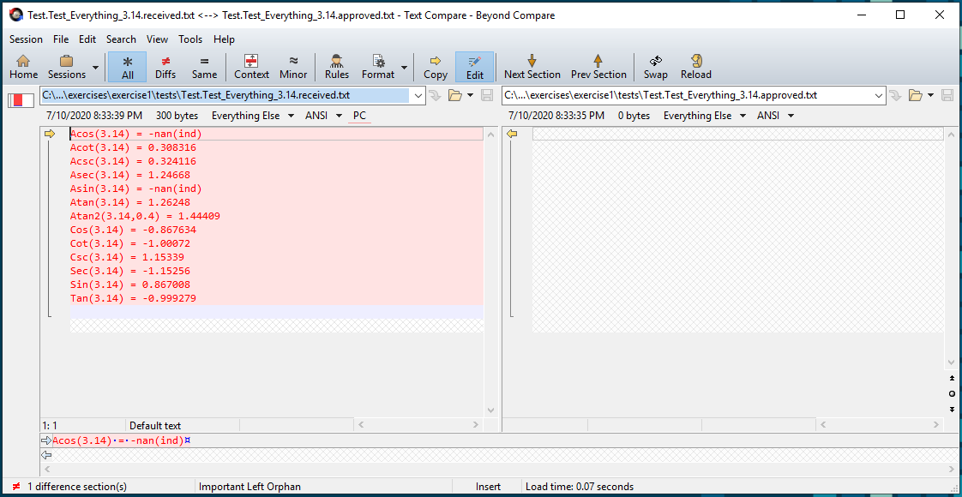
1. Capture things with Approvals
Actual
Expected
FileName.TestName.Received.txt
FileName.TestName.Approved.txt

Slide 5
2. Capture everything
0
0.828807
0.785398
1.5708
0
1.5708
0.785398
0.828807
8.54019
10.3042
1
1.20655
0.0970479
0.117093
std::string doEverything(double value)
Notes:
Basic locking – limited info

Slide 6
3. Capture informative output
0.828807 vs Sin = 0.828807 vs Sin(1.0) = 0.828807
Notes:
How can we make the output more helpful if there is a failure

Slide 7
4. Call a list of inputs
std::vector < double> inputs1 = { -0.1, 0.0, 1.0, 3.14 };
Notes:
Test a whole bunch of inputs at once

Slide 8
5. Call a combination from 2 inputs
X | -1.1 | 0.0 | 2.2 | 3.3
-1.1 | {-1.1, -1.1} | {0.0, -1.1} | {2.2, -1.1} | {3.3, -1.1}
0.0 | {-1.1, 0.0} | {0.0, 0.0} | {2.2, 0.0} | {3.3, 0.0}
2.2 | {-1.1, 2.2} | {0.0, 2.2} | {2.2, 2.2} | {3.3, 2.2}
3.3 | {-1.1, 3.3} | {0.0, 3.3} | {2.2, 3.3} | {3.3, 3.3}
Notes:
Cross product of combinations

Slide 9
Homework: Method pointers as input
std::map <std::string, TrigMathMemFn> inputs1 {
{ "Acos", &TrigMath::Acos },
{ "Acot", &TrigMath::Acot },
{ "Acsc", &TrigMath::Acsc },
{ "Asec", &TrigMath::Asec },
{ "Asin", &TrigMath::Asin },
{ "Atan", &TrigMath::Atan },
{ "Cos", &TrigMath::Cos },
{ "Cot", &TrigMath::Cot },
{ "Csc", &TrigMath::Csc },
{ "Sec", &TrigMath::Sec },
{ "Sin", &TrigMath::Sin },
{ "Tan", &TrigMath::Tan }
};

Slide 10
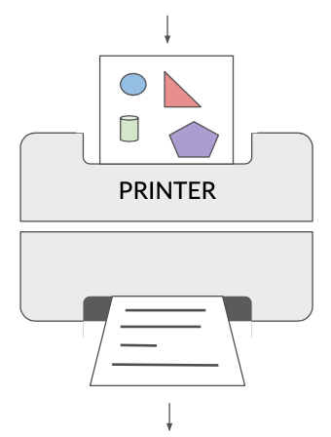
Designing Printers
Image by Emily Bache
Notes:
A Printer takes the object you are testing and converts it to string
Thanks to Emily for the word Printer
More about the design of printers…

Slide 11
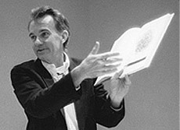
Show the Data, Show the Difference
- Edward Tufte (Author of “The Visual Display of Quantitative Information”)
Notes:
Design: We want our printing to make it easy to understand differences

Slide 12
// Create side (0,0) – (3,4)
// Verify length
Whiteboard
English
Testing Circle
Result
Code
Side (0,0) – (3,4) length = 5
Side s = new Side(0,0,3,4);
Approvals.Verify(s + " length = " +s.Length);
Notes:
We want something that reminds us of what was on the whiteboard
Approved output persists – whiteboard disappears

Slide 13
Benefits of Unit Tests
Specification
Feedback
Regression
Granularity
Notes:
Now we can start thinking about granularity and specification
Showing inputs helps to show specification
And it helps to see what’s changed with granularity

Slide 14
Telling a Story
Checking Trig Functions in main areas
Acos(-0.1) = 1.67096
Acot(-0.1) = 1.67046
Acsc(-0.1) = nan
Asec(-0.1) = -nan(ind)
Asin(-0.1) = -0.100167
Atan(-0.1) = -0.0996687
Atan2(-0.1,0.4) = -0.244979
Cos(-0.1) = 0.0332319
Cot(-0.1) = -0.339801
Csc(-0.1) = -10.2251
Sec(-0.1) = 30.0915
Sin(-0.1) = -0.0977983
Tan(-0.1) = -2.9429
Acos(0) = 1.5708
Acot(0) = -nan(ind)
Acsc(0) = -nan(ind)
Asec(0) = -nan(ind)
Asin(0) = 0
Atan(0) = 0
Atan2(0,0.4) = 0
Cos(0) = 0.00854503
Cot(0) = inf
Csc(0) = inf
Sec(0) = 117.027
Sin(0) = 0
Tan(0) = 0
Acos(0.2) = 1.36944
Acot(0.2) = 1.3734
Acsc(0.2) = -nan(ind)
Asec(0.2) = -nan(ind)
Asin(0.2) = 0.201358
Atan(0.2) = 0.197396
Atan2(0.2,0.4) = 0.463648
Cos(0.2) = 0.0977983
Cot(0.2) = 1.49915
Csc(0.2) = 15.329
Sec(0.2) = 10.2251
Sin(0.2) = 0.0652359
Tan(0.2) = 0.667046
Acos(0.8) = 0.643501
Acot(0.8) = 0.896055
Acsc(0.8) = -nan(ind)
Asec(0.8) = -nan(ind)
Asin(0.8) = 0.927295
Atan(0.8) = 0.674741
Atan2(0.8,0.4) = 1.10715
Cos(0.8) = 0.867571
Cot(0.8) = 88.5131
Csc(0.8) = 102.024
Sec(0.8) = 1.15264
Sin(0.8) = 0.00980161
Tan(0.8) = 0.0112978
Acos(1) = 0
Acot(1) = 0.785398
Acsc(1) = 1.5708
Asec(1) = 0
Asin(1) = 1.5708
Atan(1) = 0.785398
Atan2(1,0.4) = 1.19029
Cos(1) = 0.828807
Cot(1) = 8.54019
Csc(1) = 10.3042
Sec(1) = 1.20655
Sin(1) = 0.0970479
Tan(1) = 0.117093
Acos(3.14) = -nan(ind)
Acot(3.14) = 0.308316
Acsc(3.14) = 0.324116
Asec(3.14) = 1.24668
Asin(3.14) = -nan(ind)
Atan(3.14) = 1.26248
Atan2(3.14,0.4) = 1.44409
Cos(3.14) = -0.867634
Cot(3.14) = -1.00072
Csc(3.14) = 1.15339
Sec(3.14) = -1.15256
Sin(3.14) = 0.867008
Tan(3.14) = -0.999279
Notes:
You can see some of the specification here
The Title is useful
You can see a block
In fact, 6 groupings
We are using 6 different input values for these 12 functions

Slide 15
Seeing a Change
Checking Trig Functions in main areas
Acos(-0.1) = 1.67096
Acot(-0.1) = 1.67046
Acsc(-0.1) = nan
Asec(-0.1) = -nan(ind)
Asin(-0.1) = -0.100167
Atan(-0.1) = -0.0996687
Atan2(-0.1,0.4) = -0.244979
Cos(-0.1) = 0.0332319
Cot(-0.1) = -0.339801
Csc(-0.1) = -10.2251
Sec(-0.1) = 30.0915
Sin(-0.1) = -0.0977983
Tan(-0.1) = -2.9429
Acos(0) = 1.5708
Acot(0) = -nan(ind)
Acsc(0) = -nan(ind)
Asec(0) = -nan(ind)
Asin(0) = 0
Atan(0) = 0
Atan2(0,0.4) = 0
Cos(0) = 0.00854503
Cot(0) = inf
Csc(0) = inf
Sec(0) = 117.027
Sin(0) = 0
Tan(0) = 0
Acos(0.2) = 1.36944
Acot(0.2) = 1.3734
Acsc(0.2) = -nan(ind)
Asec(0.2) = -nan(ind)
Asin(0.2) = 0.201358
Atan(0.2) = 0.197396
Atan2(0.2,0.4) = 0.463648
Cos(0.2) = 0.0977983
Cot(0.2) = 1.49915
Csc(0.2) = 15.329
Sec(0.2) = 10.2251
Sin(0.2) = 0.0652359
Tan(0.2) = 0.667046
Acos(0.8) = 0.643501
Acot(0.8) = 0.896055
Acsc(0.8) = -nan(ind)
Asec(0.8) = -nan(ind)
Asin(0.8) = 0.927295
Atan(0.8) = 0.674741
Atan2(0.8,0.4) = 1.10715
Cos(0.8) = 0.867571
Cot(0.8) = 88.5131
Csc(0.8) = 102.024
Sec(0.8) = 1.15264
Sin(0.8) = 0.00980161
Tan(0.8) = 0.0112978
Acos(1) = 0
Acot(1) = 0.785398
Acsc(1) = 1.5708
Asec(1) = 0
Asin(1) = 1.5708
Atan(1) = 0.785398
Atan2(1,0.4) = 1.19029
Cos(1) = 0.828807
Cot(1) = 8.54019
Csc(1) = 10.3042
Sec(1) = 1.20655
Sin(1) = 0.0970479
Tan(1) = 0.117093
Acos(3.14) = -nan(ind)
Acot(3.14) = 0.308316
Acsc(3.14) = 0.324116
Asec(3.14) = 1.24668
Asin(3.14) = -nan(ind)
Atan(3.14) = 1.26248
Atan2(3.14,0.4) = 1.44409
Cos(3.14) = -0.867634
Cot(3.14) = -1.00072
Csc(3.14) = 1.15339
Sec(3.14) = -1.15256
Sin(3.14) = 0.867008
Tan(3.14) = -0.999279
Notes:
If the test fails, and the diff tool highlights these values in red…
Only the results of Cos changed – so that immediately tells you to look at Cos

Slide 16
Seeing a Change
Checking Trig Functions in main areas
Acos(-0.1) = 1.67096
Acot(-0.1) = 1.67046
Acsc(-0.1) = nan
Asec(-0.1) = -nan(ind)
Asin(-0.1) = -0.100167
Atan(-0.1) = -0.0996687
Atan2(-0.1,0.4) = -0.244979
Cos(-0.1) = 0.0332319
Cot(-0.1) = -0.339801
Csc(-0.1) = -10.2251
Sec(-0.1) = 30.0915
Sin(-0.1) = -0.0977983
Tan(-0.1) = -2.9429
Acos(0) = 1.5708
Acot(0) = -nan(ind)
Acsc(0) = -nan(ind)
Asec(0) = -nan(ind)
Asin(0) = 0
Atan(0) = 0
Atan2(0,0.4) = 0
Cos(0) = 0.00854503
Cot(0) = inf
Csc(0) = inf
Sec(0) = 117.027
Sin(0) = 0
Tan(0) = 0
Acos(0.2) = 1.36944
Acot(0.2) = 1.3734
Acsc(0.2) = -nan(ind)
Asec(0.2) = -nan(ind)
Asin(0.2) = 0.201358
Atan(0.2) = 0.197396
Atan2(0.2,0.4) = 0.463648
Cos(0.2) = 0.0977983
Cot(0.2) = 1.49915
Csc(0.2) = 15.329
Sec(0.2) = 10.2251
Sin(0.2) = 0.0652359
Tan(0.2) = 0.667046
Acos(0.8) = 0.643501
Acot(0.8) = 0.896055
Acsc(0.8) = -nan(ind)
Asec(0.8) = -nan(ind)
Asin(0.8) = 0.927295
Atan(0.8) = 0.674741
Atan2(0.8,0.4) = 1.10715
Cos(0.8) = 0.867571
Cot(0.8) = 88.5131
Csc(0.8) = 102.024
Sec(0.8) = 1.15264
Sin(0.8) = 0.00980161
Tan(0.8) = 0.0112978
Acos(1) = 0
Acot(1) = 0.785398
Acsc(1) = 1.5708
Asec(1) = 0
Asin(1) = 1.5708
Atan(1) = 0.785398
Atan2(1,0.4) = 1.19029
Cos(1) = 0.828807
Cot(1) = 8.54019
Csc(1) = 10.3042
Sec(1) = 1.20655
Sin(1) = 0.0970479
Tan(1) = 0.117093
Acos(3.14) = -nan(ind)
Acot(3.14) = 0.308316
Acsc(3.14) = 0.324116
Asec(3.14) = 1.24668
Asin(3.14) = -nan(ind)
Atan(3.14) = 1.26248
Atan2(3.14,0.4) = 1.44409
Cos(3.14) = -0.867634
Cot(3.14) = -1.00072
Csc(3.14) = 1.15339
Sec(3.14) = -1.15256
Sin(3.14) = 0.867008
Tan(3.14) = -0.999279
Notes:
If the test fails, and the diff tool highlights these values in red…
Only the results of input 3.14 changed – so that immediately tells you to look at how Pi is used

Slide 17
Seeing a Story
TEST_CASE("Graphing")
{
std::stringstream s;
TrigMath math;
for ( double i = 0; i <= 6.28; i += 0.01)
{
s << i << ',' << math.Sin(i) << '\n';
}
Approvals::verify(
s.str(),
Options().fileOptions().withFileExtension(".csv"));
}
Notes:
Can we visualise the story?

Slide 18
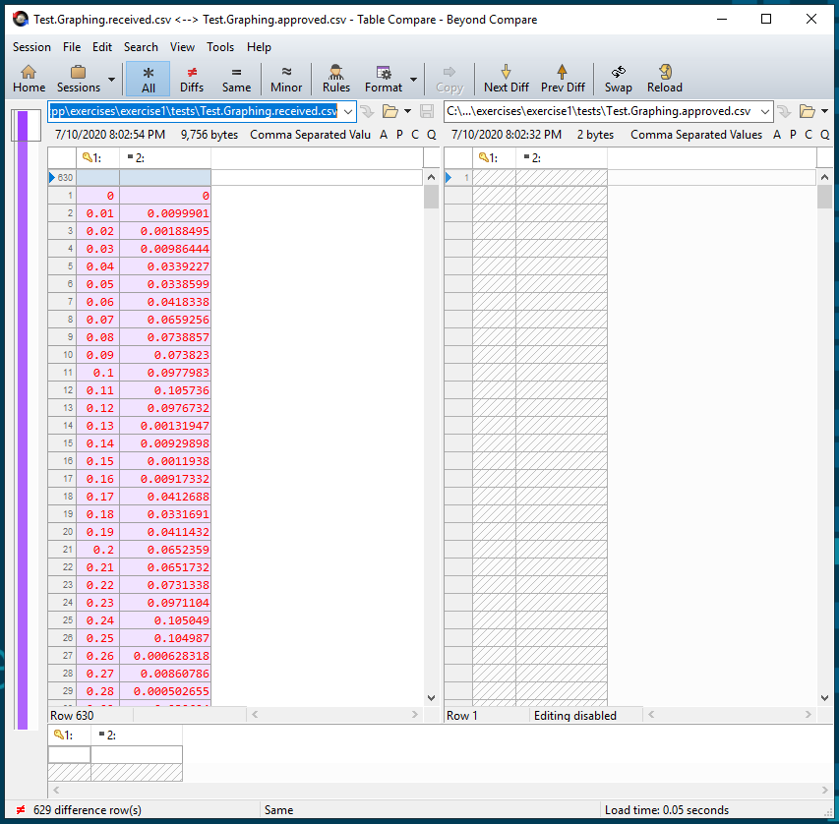
Seeing a Story

Slide 19
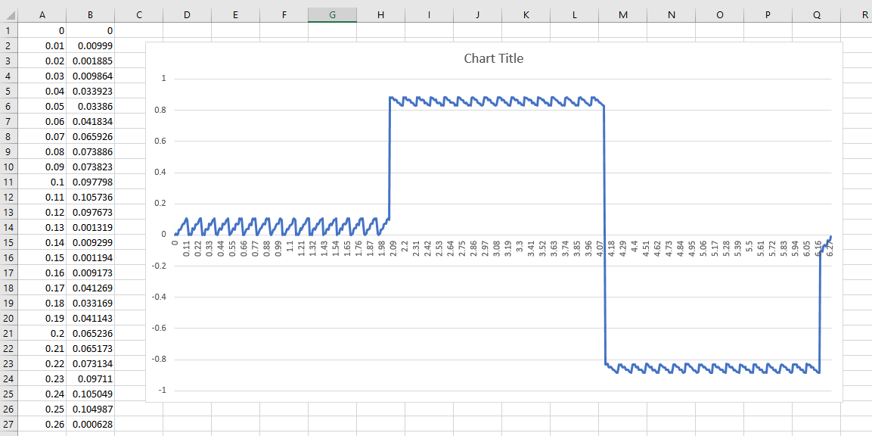
Seeing a Story

Slide 20
Arrange Act Assert
Notes:
Typical explanation of parts of a unit test

Slide 21
Arrange Act Assert
Given When Then
Notes:
The BDD parts (Behaviour Driven Development)
Equivalent

Slide 22
Arrange Act Assert
Given When Then

Slide 23
#1
TEST_CASE("Test Setup") {
TrigMath math; // Arrange
REQUIRE(math.DEG_TO_RAD == Approx(0.0174532925)); // Assert
}
#2
TEST_CASE("Test Function") {
auto result = pow(2, 3); // Act
REQUIRE(result == Approx(8)); // Assert
}
Notes:
Not everything has all 3 parts
Though Assert is required!

Slide 24
Arrange Act Assert
Given When Then
Notes:
You must have at least an arrange or an act.
Can’t just have an assert.

Slide 25
Do Verify
Notes:
So we think of it as…

Slide 26
Stages of Approvals::verify()
verify()
writes "received"
Same?
Pass
Fail
Reporter
object
reads "approved"
Notes:
What’s actually happening with Approvals

Slide 27
Types of Fialure Failuer Change
Improvement
Bug
Change the code
Change the test
Fail
Notes:
There are two types of test failure
The code has been improved
You have introduced a bug

Slide 28
Homework
Redo the exercise, solo
Take notes around printing
Existing:
Classes:
Ideas:
Notes:
Redo this exercise by yourself, on your own computer
Take notes around printing
Existing: What did you find to display data as text?
Classes: Which objects would benefit from a printer?
Ideas: What would the printer output be like?
We’ll compare notes next week...

